Slide 1

Internews
Introduction

Slide 2

Telling it differently
= Media development organizations train & mentor journalists to produce compelling, in-depth stories
The first data journalism training in Kenya (2011)
Lessons learnt
Journalists lacked basic technical skills
They needed a lot of mentoring
Editors did not have much experience in big data storytelling

Slide 3
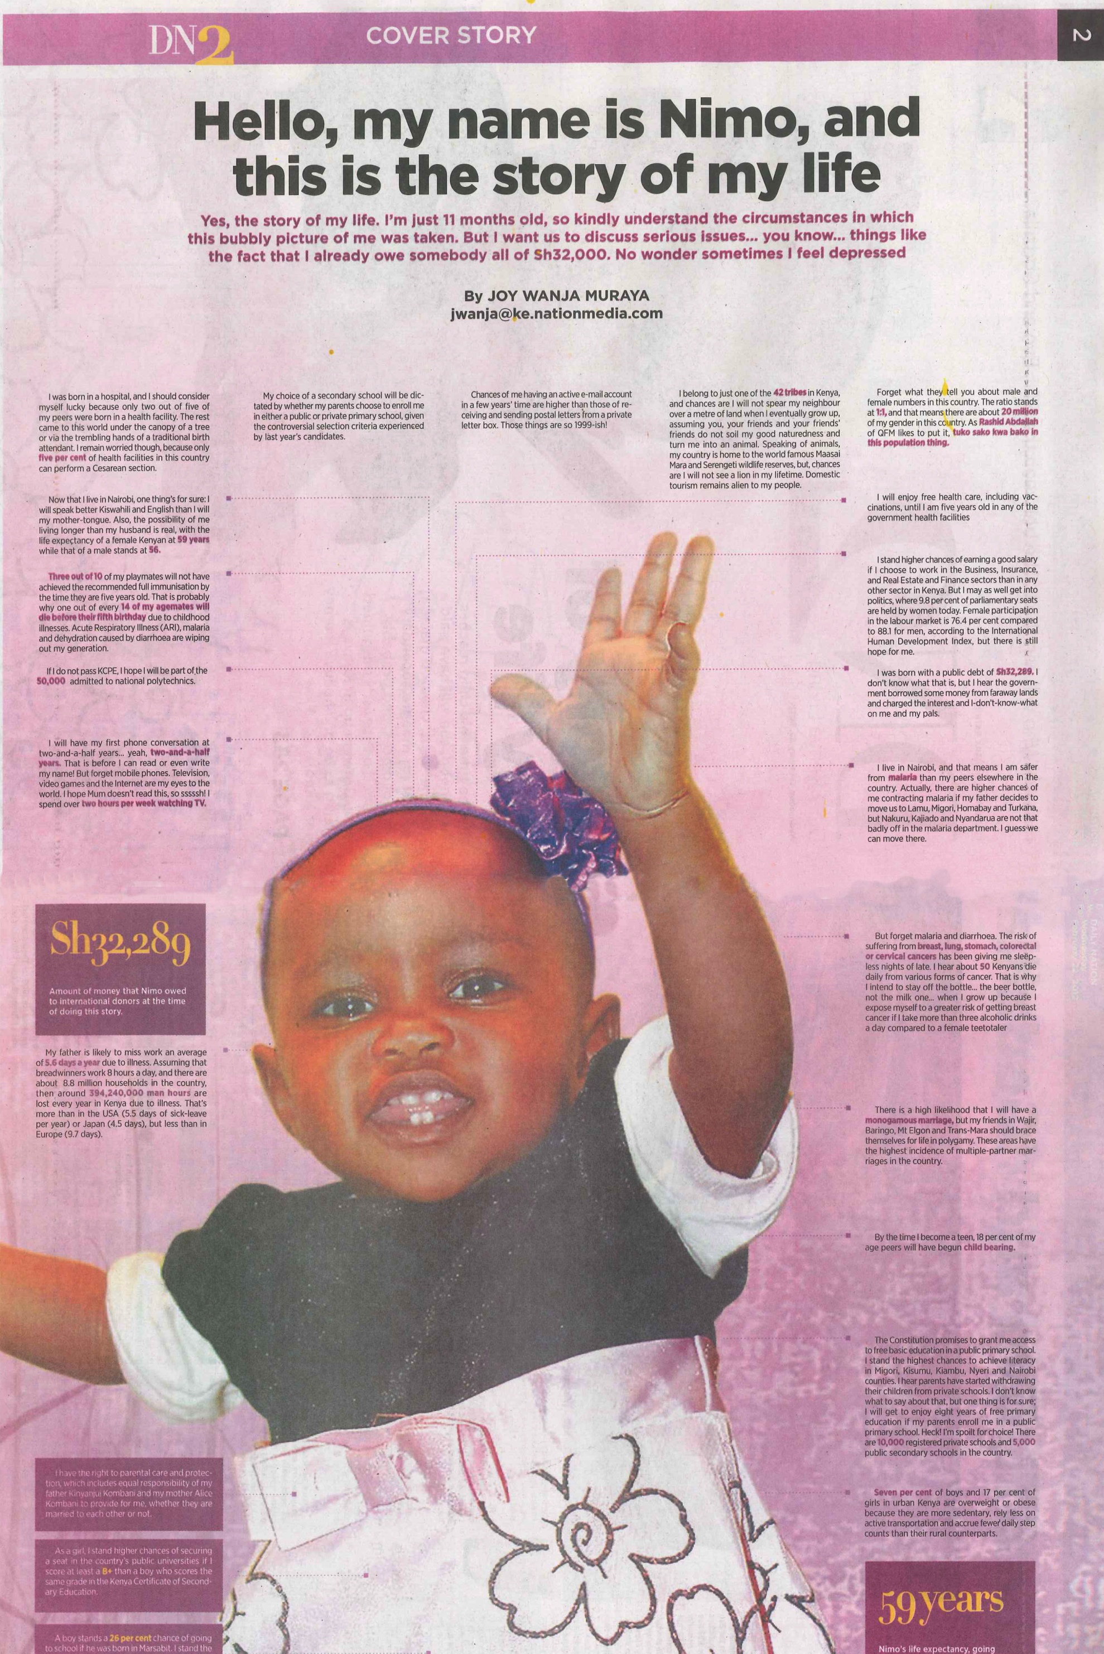

Slide 4
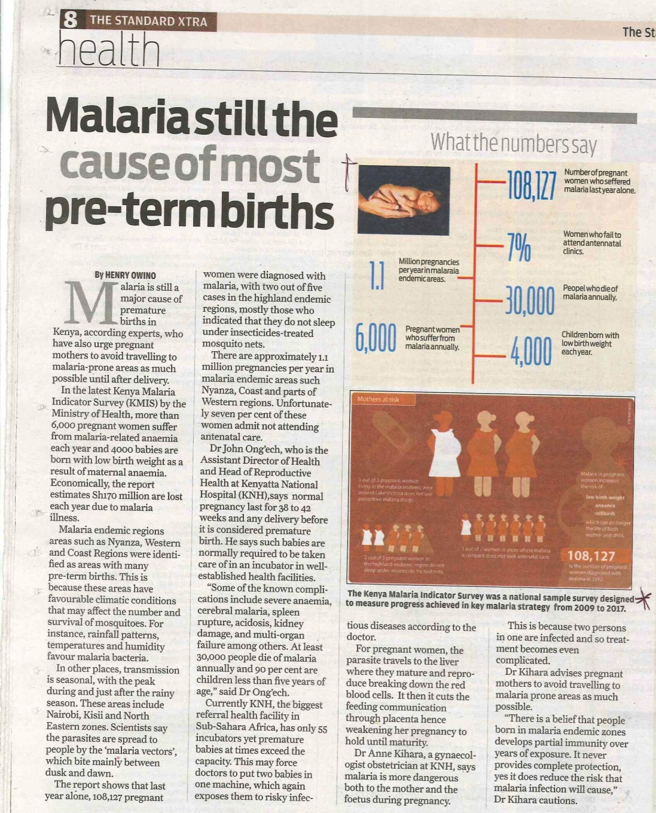

Slide 5
Data journalism training 2.0
Train in teams – to promote teamwork
Fellowship – long term learning
Data Dredger
A tool to promote data journalism
in a low numeracy environment

Slide 6
How the Dredger works
www.internewskenya.org/dataportal
Women winners
Malaria story playback
Exercise:
Download:
An infographic that relates to malaria in children
Find data on ITNs coverage

Slide 7
Newspapers warm up to data visualizations

Slide 8
Any Questions?

